Slide 1
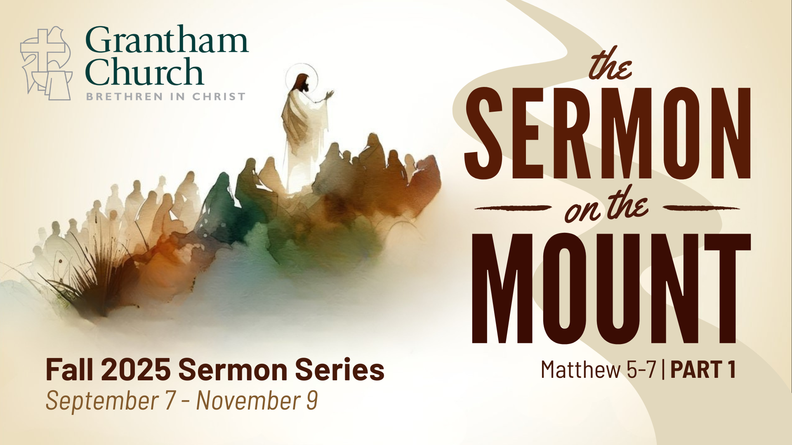
Notes:
[BRIEF INTRO]
We are continuing part 1 of our sermon series on the core teachings of Jesus, which are found in what is known as the Sermon on the Mount in Matthew chapters 5-7.
If you’re just joining us, the Sermon on the Mount is the most… [NEXT SLIDE]

Slide 2
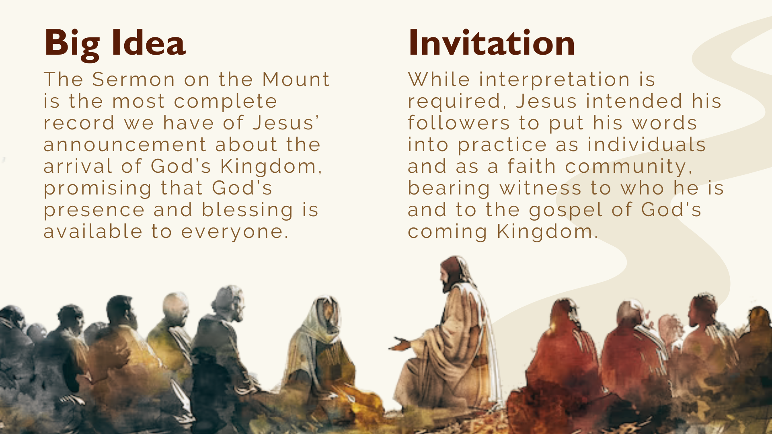
Notes:
…complete record we have of Jesus’ announcement about the arrival of God’s Kingdom, promising that God’s presence and blessing is available to everyone. In the Sermon on the Mount, Jesus proclaims the gospel of the Kingdom and casts a vision of “righteousness”—i.e., what it looks like to live in right relationship with God, our neighbors, and our enemies.
It’s true that interpretation and conversation are necessary when reading and seeking to apply Jesus’ words, but we want to be clear that Jesus intended his followers to put his words into practice as individuals and as a faith community, bearing witness to who he is and to the gospel of God’s coming Kingdom. Those who do this are his true disciples.
Once again, here is the 3-part structure to the Sermon on the Mount that’s helpful in understanding the flow and aim of Jesus’ message … [NEXT SLIDE]

Slide 3
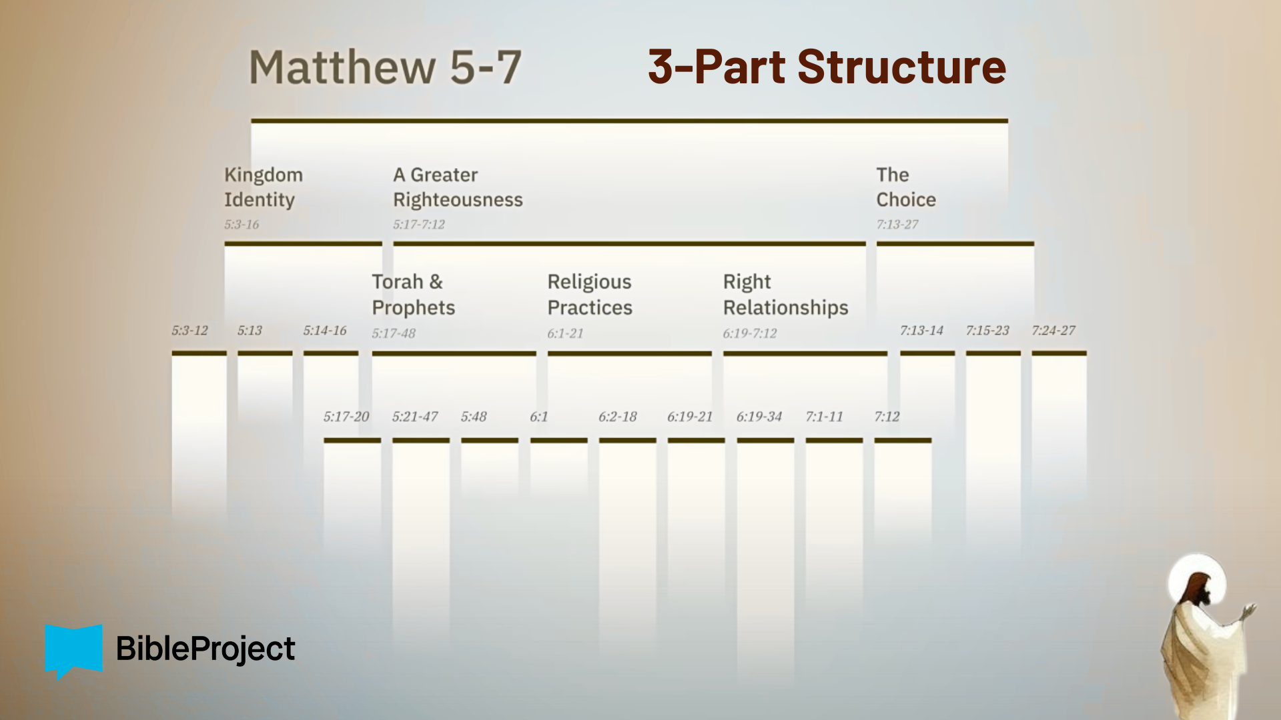
Notes:
Look at the top there; the Sermon on the Mount contains 3 major sections, and the middle section (main body) itself has 3 parts, and each middle part breaks into 3 parts, as well.
Three weeks ago, we began our series with the first two verses of the choice. In Matt. 7:13-14, Jesus said there are two paths, a wide road to destruction and a narrow road to life. And so, we started with the end in mind so that we will continually keep before us the invitation to walk the narrow path of Jesus. Two weeks ago, we covered the Beatitudes and what Jesus says is “the good life” for those who choose to follow him and enter his Kingdom. And then last week, we concluded the opening of the sermon with Jesus’ call for his followers to be salt and light in the world—to push back on the darkness and decay of the world with the light of our witness; by embodying the good life of the Kingdom of God.
That leads us to today’s message, where we begin the main body of Jesus’ sermon, which we’re calling… [NEXT SLIDE]

Slide 4
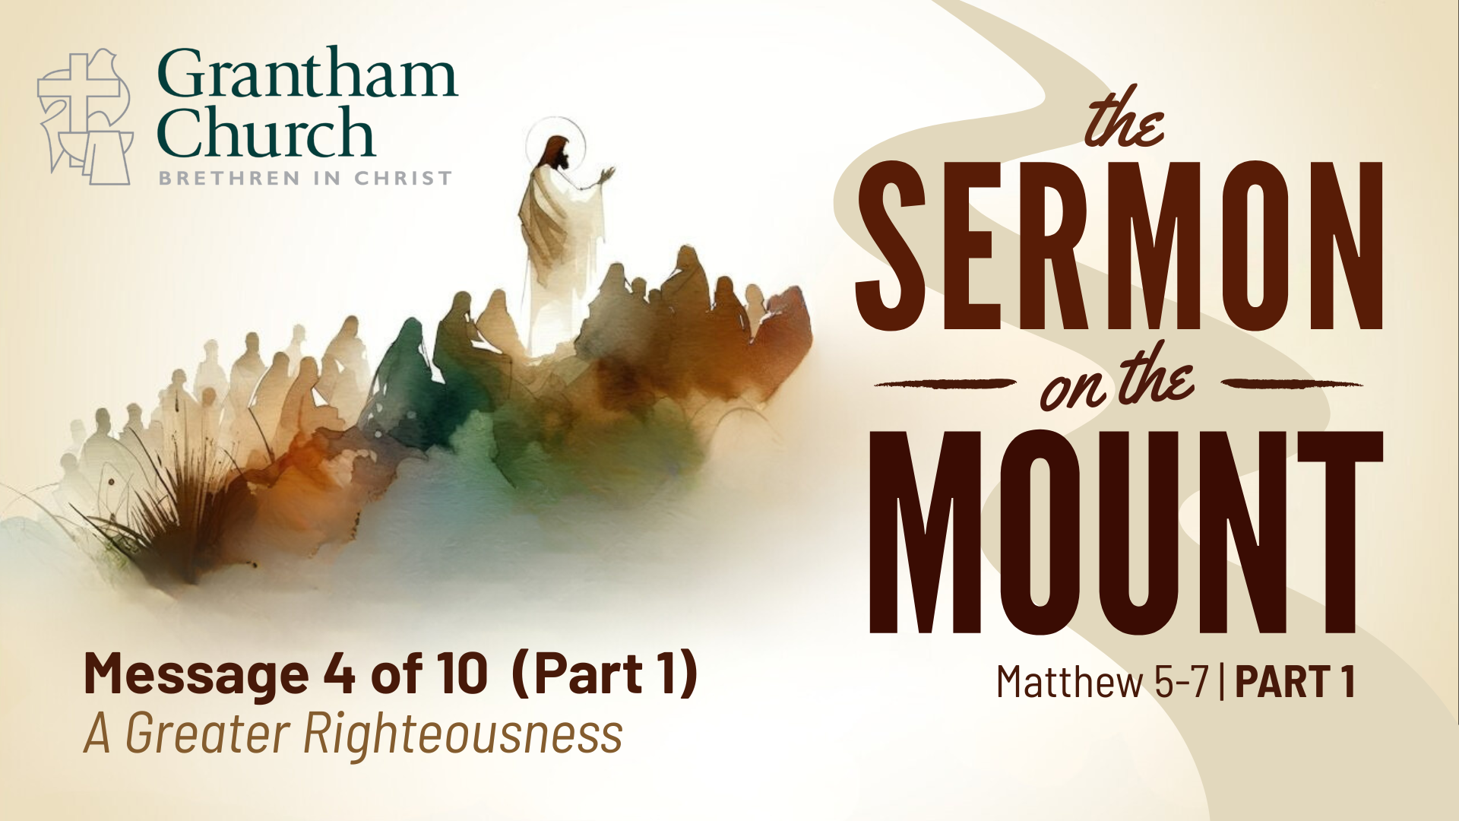
Notes:
A Greater Righteousness. If you’re taking notes, that is the title of the fourth message in our series, where we will be going verse-by-verse through Matthew 5:17-20.
Please turn with me there… [NEXT SLIDE]

Slide 5
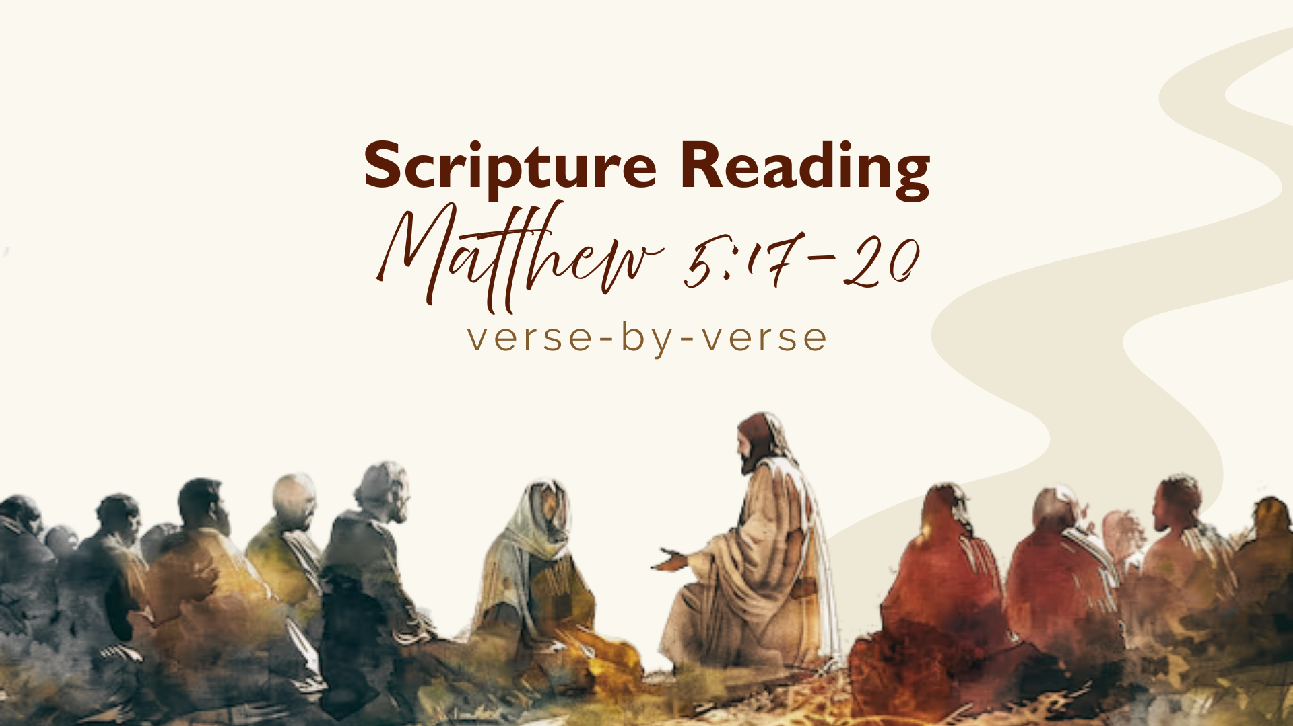
Notes:
[INVITATION TO STAND FOR SCRIPTURE READING]
Raise your hand if you’ve been a Christian for more than 10 years. Keep your hand up if you can name the first five books of the Bible, without looking. [CALL ON SOMEONE]
The first five books of the Bible (Genesis, Exodus, Leviticus, Numbers, and Deuteronomy) are referred to as the Torah in the Jewish world. In Hebrew, torah simply means “teaching,” but it’s often translated as “the Law” in our Bibles. But to be clear, these books aren’t merely laws. The Torah is a story about God creating the world, making humankind in his image, and tells of his plan to partner with humans in ruling the world. And when humans ruin that partnership through idolatry, violence, injustice, etc., God begins a rescue plan—first by establishing a people who would worship him and not the lesser gods, and then rescuing that people, the Israelites, with the purpose of inviting them into a covenant relationship.
After then after the Torah come the Prophets, which continue the story of the Hebrew Bible. Don’t worry, I’m not going to ask anyone to name them all. The prophets wrote about how Israel failed to live by God’s wisdom by violating those commands and turning their backs on him. But the prophets, often with poetry and powerful rhetoric, proclaimed that their failure to uphold the covenant would not be the end of the story. God was going to bring his partnership with Israel to its fulfillment and welcome all nations into his salvation.
And so, Jesus and other ancient Israelites believed that the Torah and Prophets revealed God’s wisdom and that by meditating on them a person can live in right relationship with God and their neighbors. Now, knowing all of that, let’s go verse-by-verse.
[READ VERSE-BY-VERSE]
v. 17 – The word translated as “fulfill” is plerao, which means ”to fill up” or “make full.” What does Jesus coming to “fill the Torah and Prophets full” mean? Well, first, the Law and Prophets is shorthand for the entire Old Testament, including the writings. And the Scriptures tell the story of God’s plan to partner with Israel and all humanity in ruling the world. And so, Jesus is saying that he is moving that story forward, showing humans what it’s really like to be righteous and live by God’s wisdom. And Jesus is telling his audience that his vision of righteousness (what it looks like to be in right relationship with God and others) is more in line with God’s wisdom than anyone else’s in his day. That is quite the claim. And he’s still calling us to believe it today.
[ILLUSTRATION: BLUEPRINTS]
Without the building, the blueprint is just a set of plans and a detailed design structure. Without the blueprint, we don’t understand everything about the building.
So, the Law and Prophets (the Old Testament) is the blueprint detailing the design, the plans, and promises of God; and Jesus is the completed building—the design, plans, promises, and purposes of the Father made manifest in his Son. Which is then what the NT expounds upon—Jesus as the Word made flesh; God’s will in human form.
Therefore, Jesus is saying that he didn’t come to throw away or destroy the plans (the Law & Prophets) but to bring them to completion; to reveal what God intended.
Now, why would Jesus begin this way? “Do not think I have come to “abolish” or “demolish” or “destroy” the Scriptures…” Well, it’s because of these guys… [NEXT SLIDE]

Slide 6
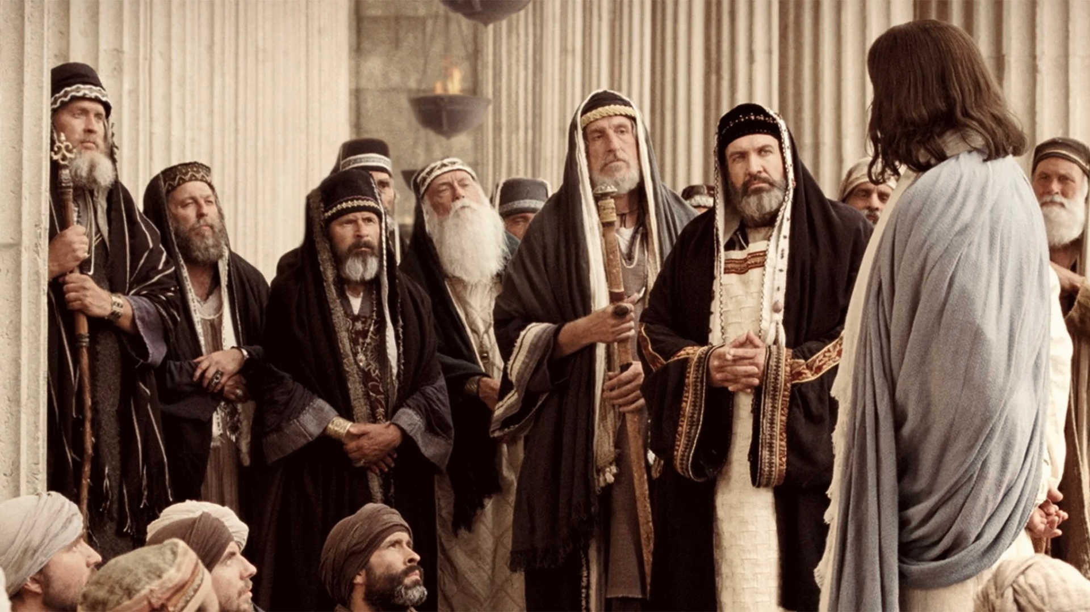
Notes:
…the Pharisees and the teachers of the Law (Torah). Remember that there were various religious groups in Jesus’ day (the Pharisees and teachers of the Law, the scribes, the Sadducees, etc.); and they all had different opinions about how to interpret the law of Moses with its 613 laws, which by the way was over a thousand years old in Jesus’ day.
Think about that. A lot had changed in a thousand years—the culture, the context, their situation. How should we interpret Torah? How should it be applied? There was much disagreement and they all wanted common folks to side with them because each group believed their way was the right way. The Pharisees, the largest and most popular of the religious leaders, would fill in the gaps in the law by discerning God’s wisdom underneath the commands to apply to other areas of life. And many of them believed (even accused) Jesus of not having a high view of Scripture, based on things they heard Jesus say and do; e.g., how he seemingly disregarded ritual purity laws, how he healed people on the Sabbath, and didn’t want to stone people for various offenses, as outlined in the Law of Moses.
But as we will see, it’s not the Hebrew Scriptures that Jesus takes issue with, but rather the way in which it was being interpreted and applied. And remember what Jesus said in John 5:39-40: “You study the Scriptures diligently because you think that in them you have eternal life. These are the very Scriptures that testify about me, yet you refuse to come to me to have life.” Back to Matthew 5, verse 18… NEXT SLIDE]

Slide 7
Notes:
[READ VERSE-BY-VERSE & COMMENT]
v. 18 – “the least stroke of a pen” – the smallest squiggles of Hebrew letters; “until everything is accomplished” or “until its purpose is achieved” – the end of human history
v. 19 – “sets aside” – loosens or dissolves; “least of these commands” – some commands are “lesser” or more specific to application (how to live it out); others are “greater” or more general; larger principles (e.g., be merciful, gracious, loving, etc.).
v. 20 – “surpasses that of the Pharisees” – with all their sub-rules and cleaning the outside of the cup, rather than the inside (the heart; inner transformation by the Spirit)
This would have been a shocking statement. It’s a bold claim. But as we’ll see in the Sermon on the Mount, Jesus is offering a big Kingdom vision of human life. He’s showing how we can relate to God, deal with the sin that is in our hearts, build healthy communities, heal broken relationships, and transform hostility into honor and respect. And in the next section of the sermon, Matthew 5:21-48, we will hear Jesus give six case studies showing how to do that. Each time, he’ll quote a command from the Torah and then explain how it reveals God’s wisdom so that we can consistently love God and do right by our neighbor.
And remember, that’s how Jesus sums up the Hebrew Scriptures. Later on in chapter 7 he will say… [NEXT SLIDE]

Slide 8
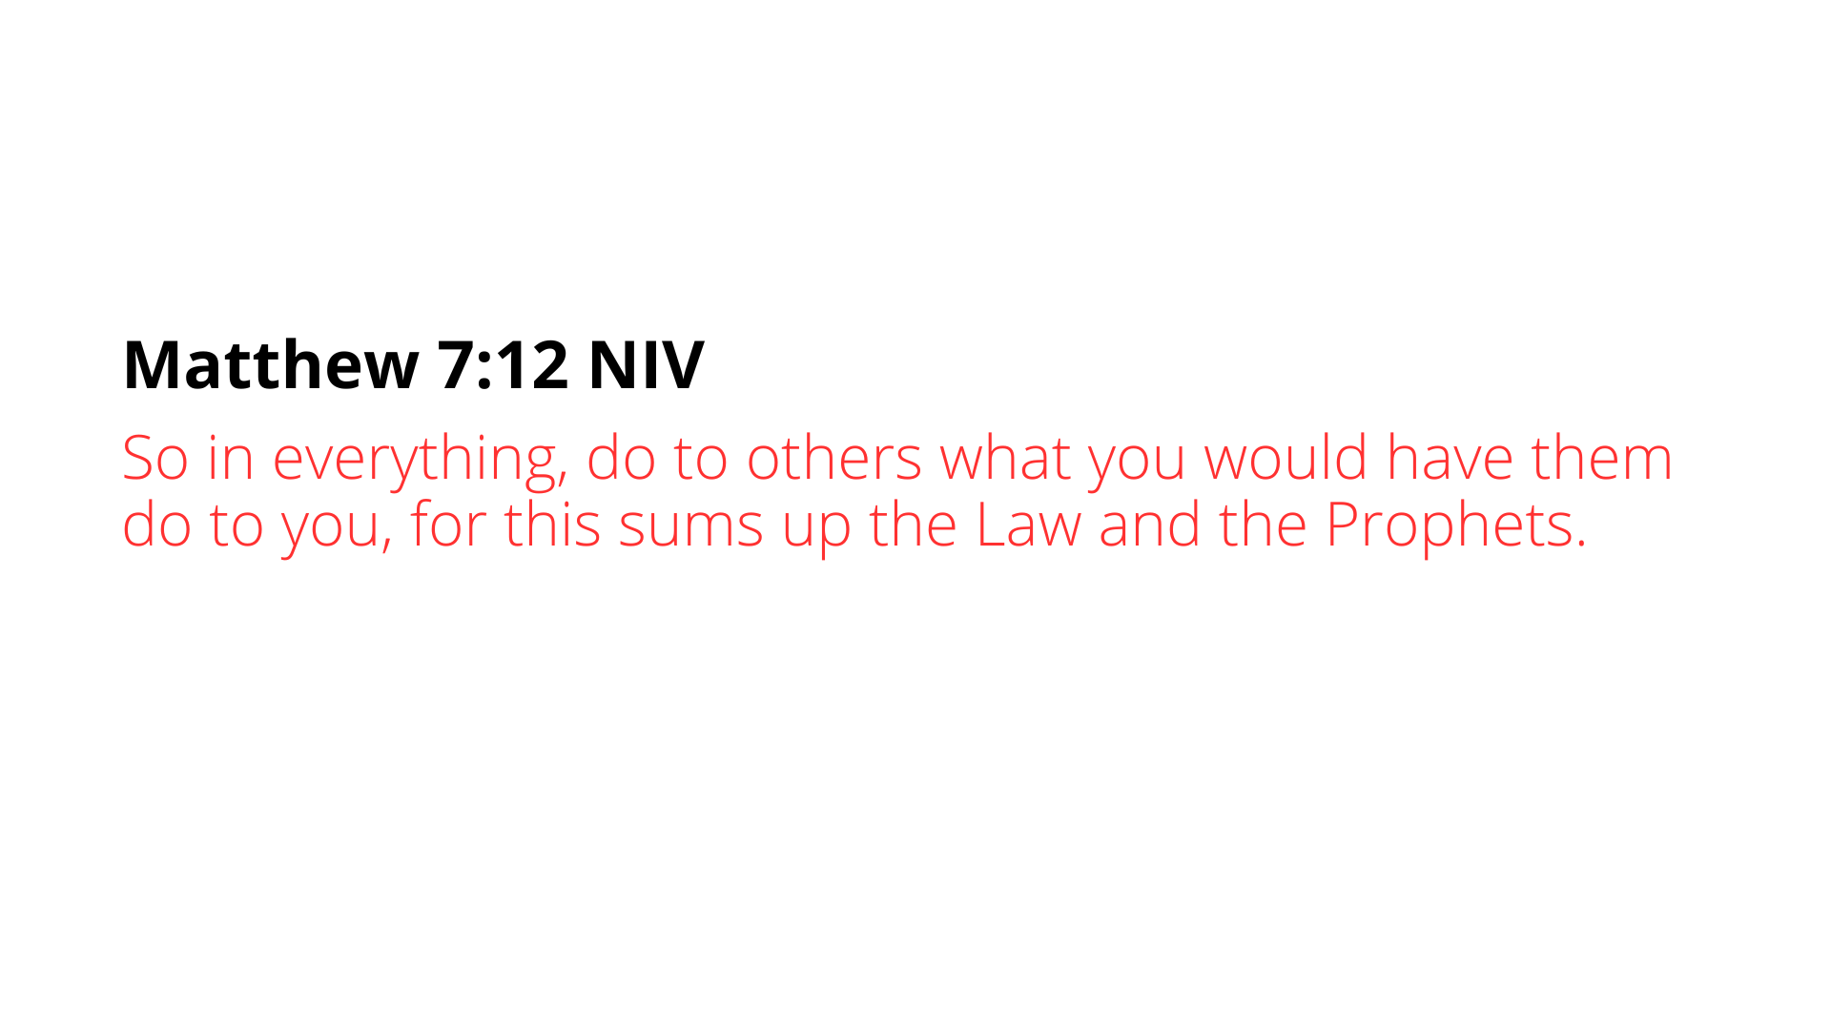
Notes:
[READ & COMMENT] – the Golden Rule
Yes, it’s true that there are other religious and philosophical traditions that express this idea, but it is done negatively. For example, Rabbi Hillel (a contemporary of Jesus) said, “What is hateful to you, do not do to your neighbor. That is the whole Torah; the rest is commentary.”
But the way Jesus puts it: “do to others what you would have them do to you”… is not just restraint; it’s proactive love. Instead of merely avoiding harm, Jesus calls us to actively do good, seek others’ well-being, and initiate love and mercy. And he says, this teaching sums up the story of God, his people, and his salvation, as told in the Hebrew Scriptures.
And then later in Matthew’s gospel, Jesus responds to an expert in the Law of Moses who asked him what is the greatest commandment. Jesus replied… [NEXT SLIDE]

Slide 9
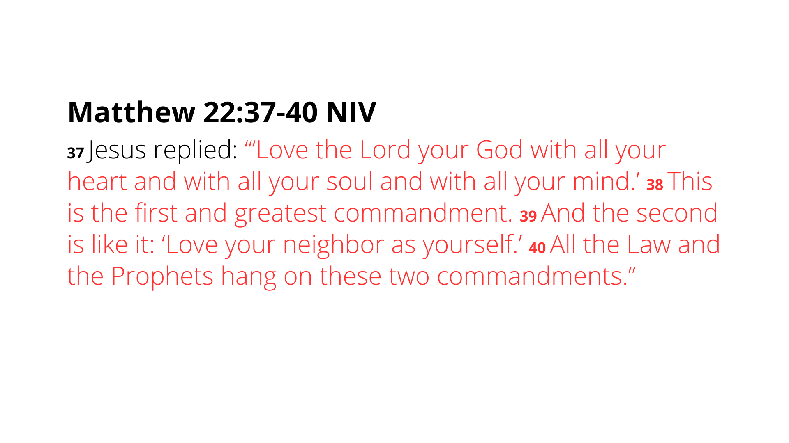
Notes:
[READ & COMMENT]
The first and greatest commandment that Jesus is quoting is from Deut. 6:4-5; the second commandment is from Lev. 19:18.
What does it mean that the Law and Prophets “hang” on these two commandments? Well, let’s see it in an image… [NEXT SLIDE]

Slide 10
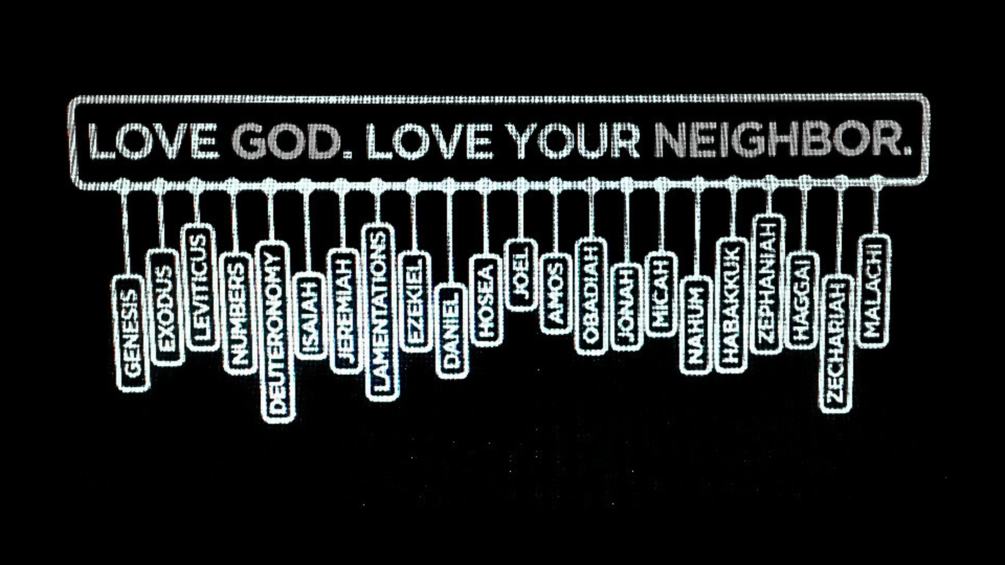
Notes:
[COMMENT ON IMAGE]
Jesus is saying that everything written in the Law and Prophets, the Hebrew Scriptures, our Old Testament, is ultimately all about him… and you will be honoring and abiding by everything in it if you are loving God with all that you are and loving your neighbor as you love your self. Any interpretations that detracts from that… has missed the point of it all. So, if you want the right interpretation and what it looks like to live it out… listen to Jesus, the Teacher, and follow him as he perfectly embodies the righteousness of God.
Now, let’s sum up what we’ve heard Jesus say in Matthew 5:17-20, reflect on his meaning, and consider what it looks like to apply it to our lives… [NEXT SLIDE]

Slide 11
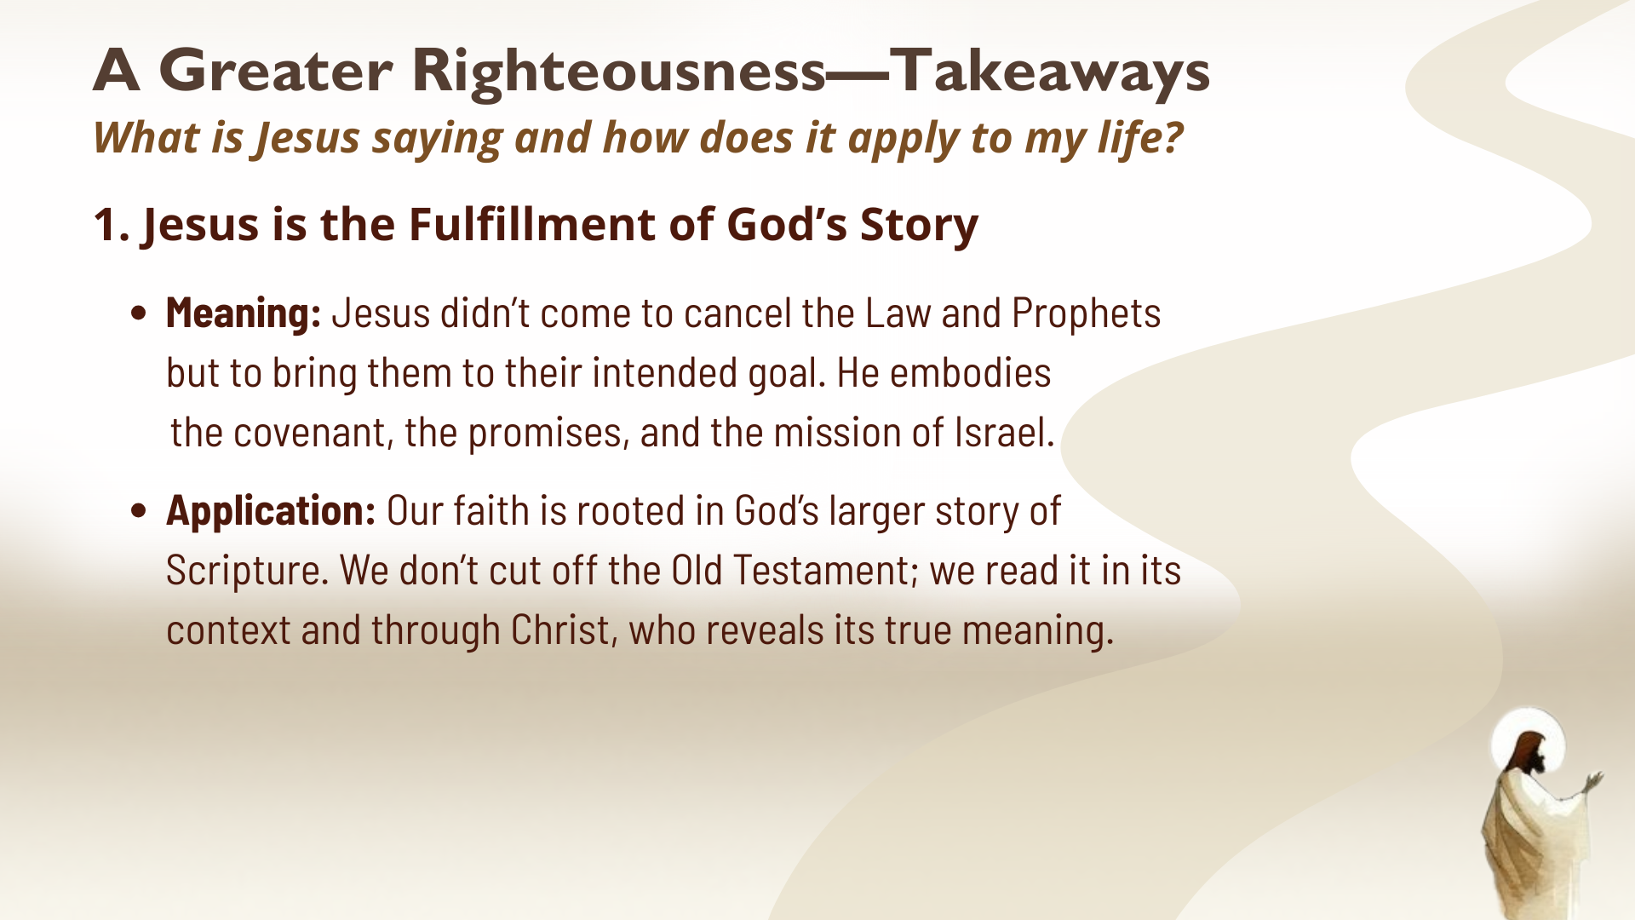
Notes:
[READ SLIDE & COMMENT]
Think of a movie trilogy. You don’t stop at the first two movies—you wait for the finale to see how the story comes together. Ex. Original Star Wars trilogy
So, the Bible is like a movie or a play, and Jesus is the “final act” that makes sense of all that came before. Therefore, we must listen to Jesus.
Which brings us to Takeaway #2… [NEXT SLIDE]

Slide 12
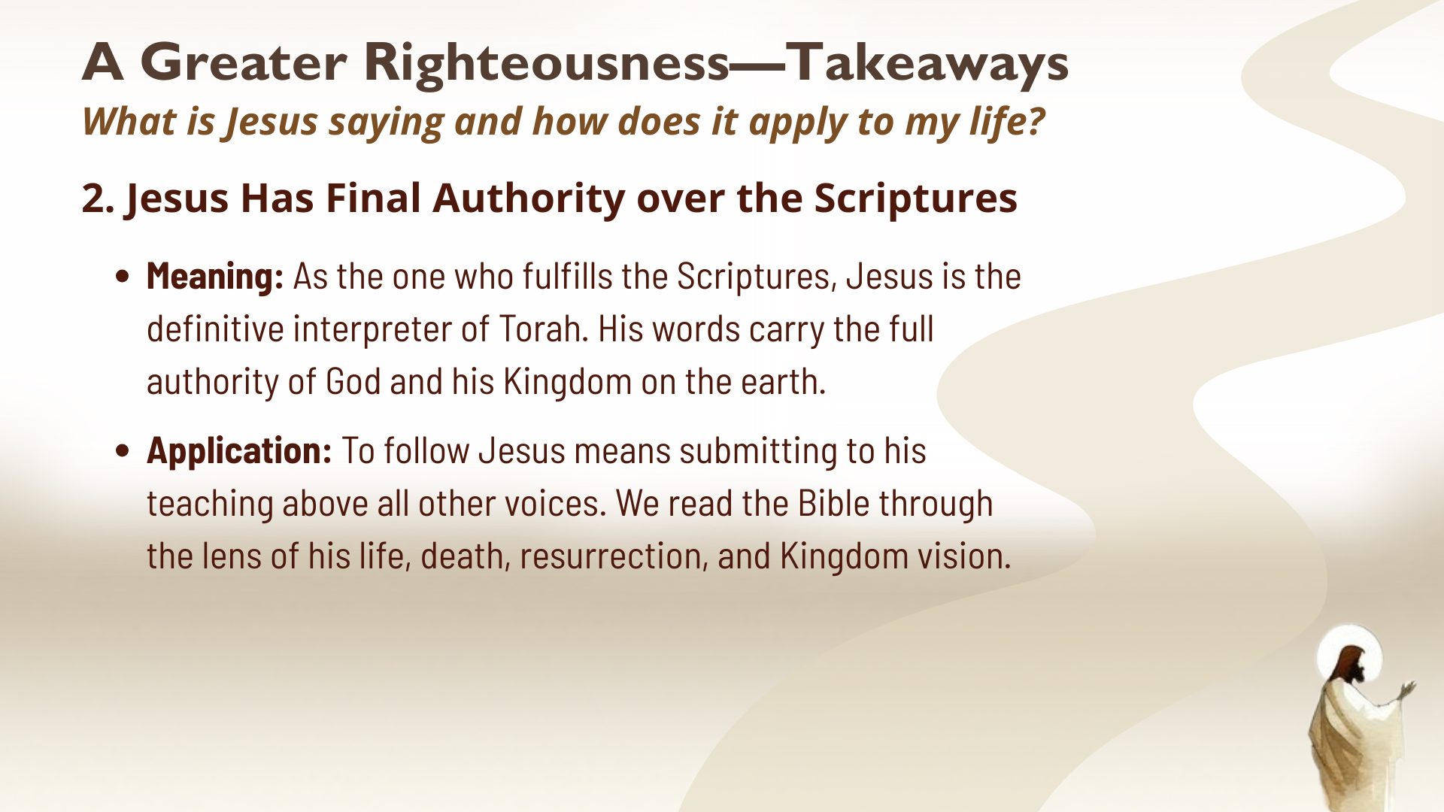
Notes:
[READ SLIDE & COMMENT]
Folks, if we’re honest, many evangelicals just flatten out their Bible and treat it all as equally authoritative; pulling verses out of context and just picking and choosing based on whatever it is they want to justify (e.g., waging war, using violence against enemies, demonizing gay people, seeking political power, etc.); and they completely disregard the way Jesus reads the Old Testament, interprets the Law & the Prophets, and shows us what it looks like fulfilled in him; and what it looks like lived out the way God intended. And so, we just jump over Jesus to support all kinds of carnality—pretending as it there isn’t a new covenant in Christ’s blood.
But as we will hear from Jesus, his real followers don’t do that. Takeaway #3… [NEXT SLIDE]

Slide 13
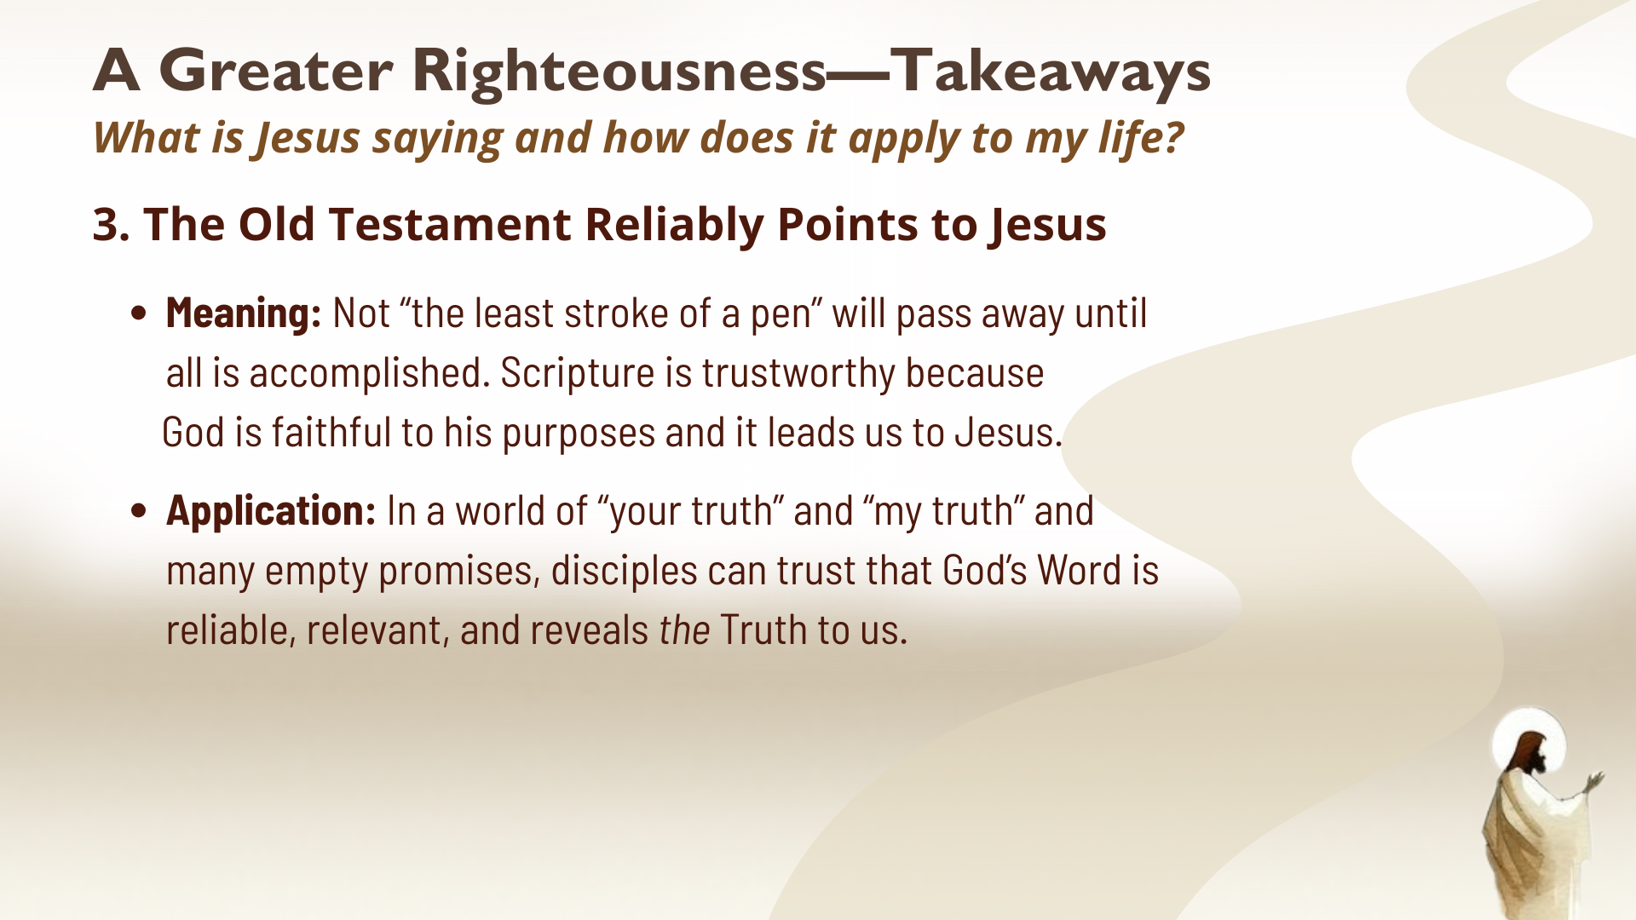
Notes:
[READ SLIDE & COMMENT]
Friends, there is no room in the thinking of Christ-followers to belittle or downplay the significance of the Old Testament. If you’re tempted to do that, I want to respectfully submit to you that it’s because you’ve not come into an understanding and appreciation of not only its literary sophistication, but more importantly its divine inspiration and life-changing power when understood in its context and how it ultimately points to Jesus of Nazareth.
It’s sort of like that older M. Night Shyamalan movie, The Sixth Sense, with Bruce Willis. Spoiler Alert: It isn’t until you get to the end of the movie that you realize that Bruce Willis’ character has been dead the whole time, and then it forces an entire reframe of everything you’ve just watched. Just like that… we simply need to learn to read the OT through the lens of the cross. Because Jesus forces a double-take and an entire reframe of everything that came before him. For if God looks like Jesus, than he has always looked like Jesus, and there has never been a time that God hasn’t looked like Jesus. We’ve not always known that. But we do now.
Takeaway #4… [NEXT SLIDE]

Slide 14
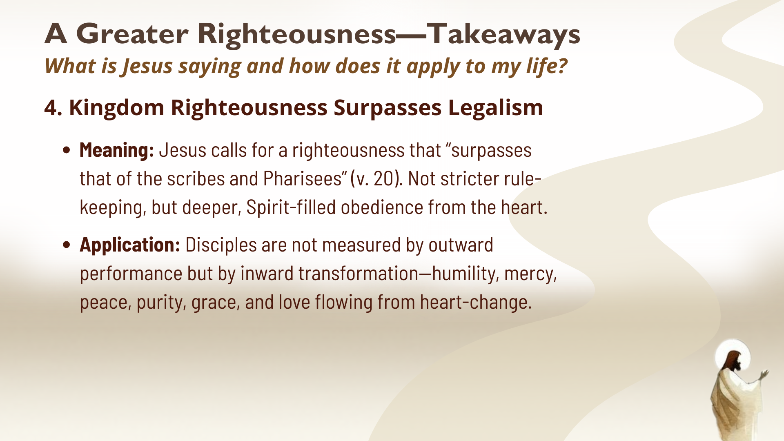
Notes:
[READ SLIDE & COMMENT]
Parents, we know that a child cleaning their room just enough to get by vs. cleaning it because they love and honor their parents, is quite different. The difference is motive. Jesus wants obedience born of love, not bare minimum compliance.
But if we’re going to have a change of heart (where motives are born), and surpass the righteousness of the uppity up religious people, we will need the Lord’s help.
Just imagine trying to jump across the Grand Canyon. Some may jump farther than others, but no one makes it across. We need a bridge. Jesus himself is the bridge. And his Spirit empowers us to walk the narrow path of his own righteousness.
And lastly, takeaway #5… [NEXT SLIDE]

Slide 15
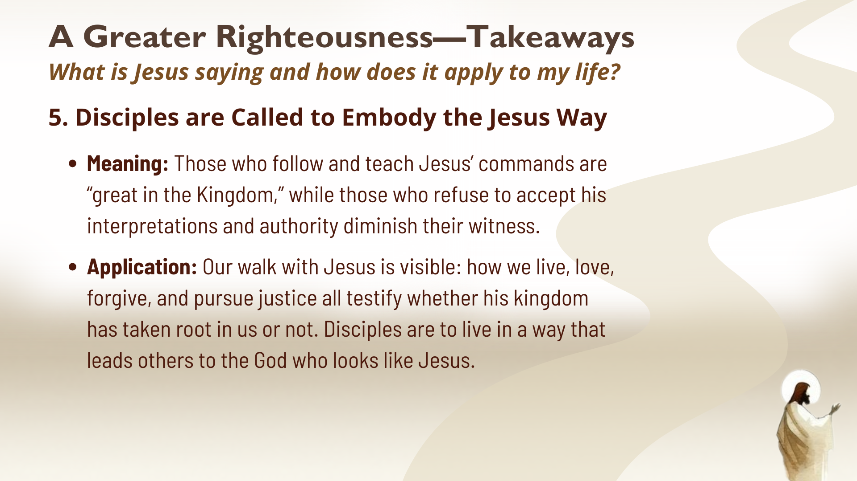
Notes:
[READ SLIDE & COMMENT]
Brothers and sisters, as we prepare to hear six examples in the coming weeks of how Jesus interprets various teachings of the Torah, let’s be clear about this: Jesus reveals a greater righteousness; He shows us what it looks like to be in right relationship with God, with our neighbors, and our enemies.
So… let us trust Jesus as the one who fulfills God’s promises, who can give you a new heart, and who invites us all into a Kingdom life that surpasses rule-keeping and flows from love.
Finally, here are some questions to help us reflect and respond together… [NEXT SLIDE]

Slide 16
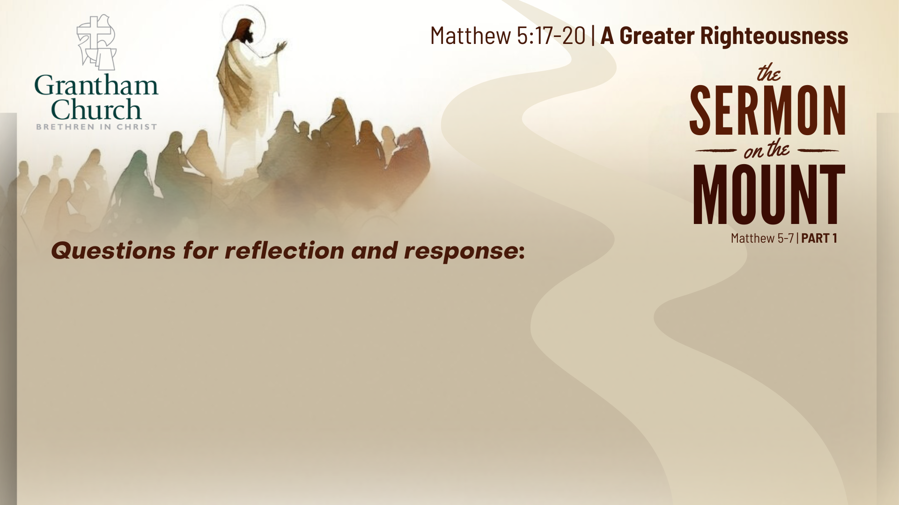

Slide 17
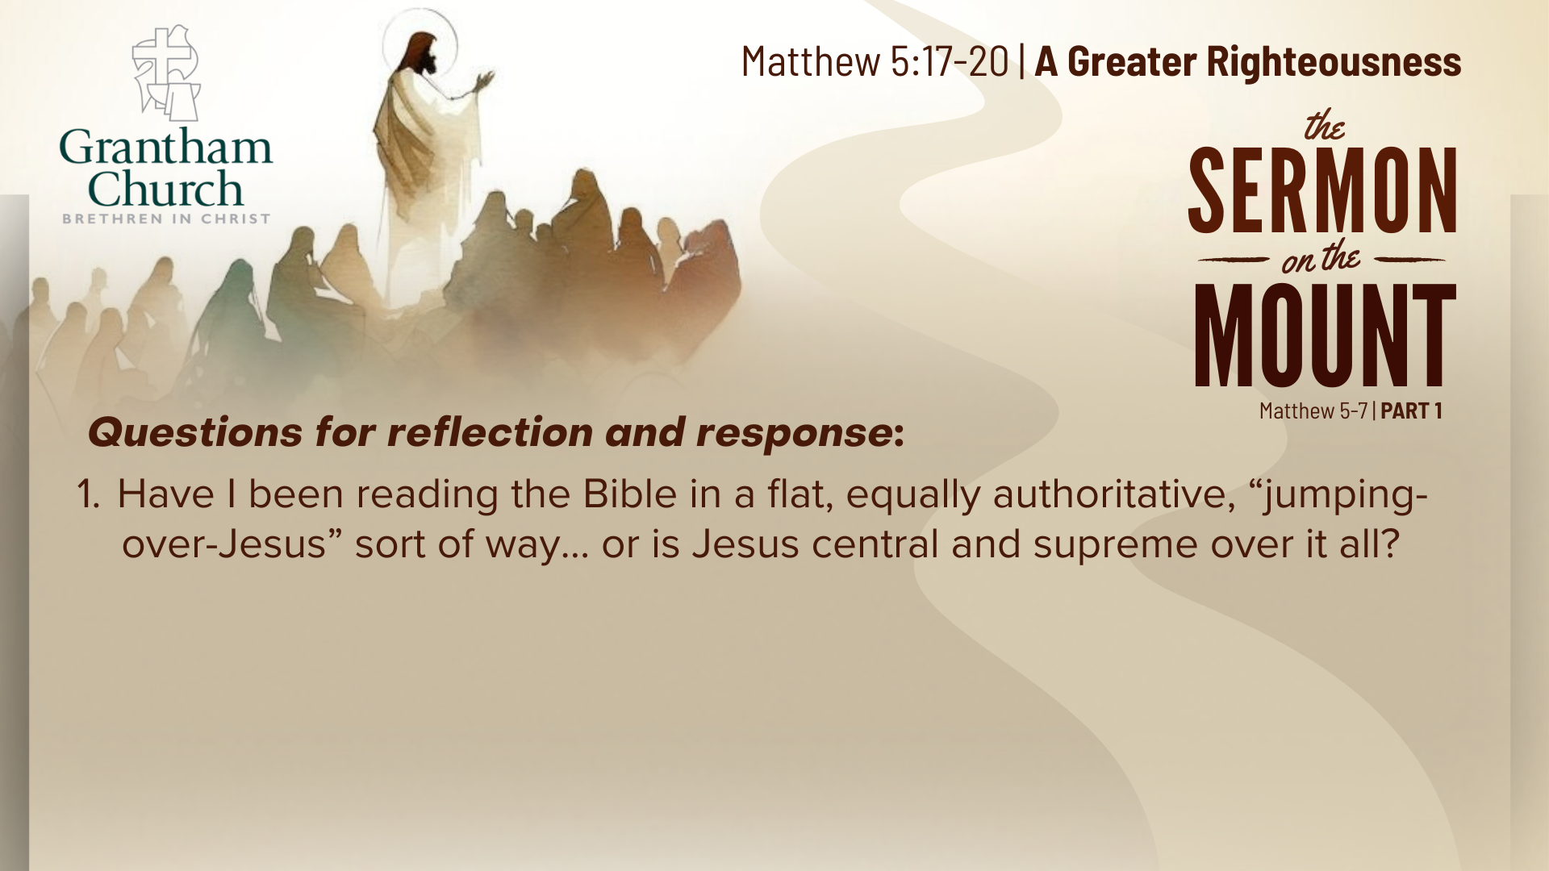

Slide 18
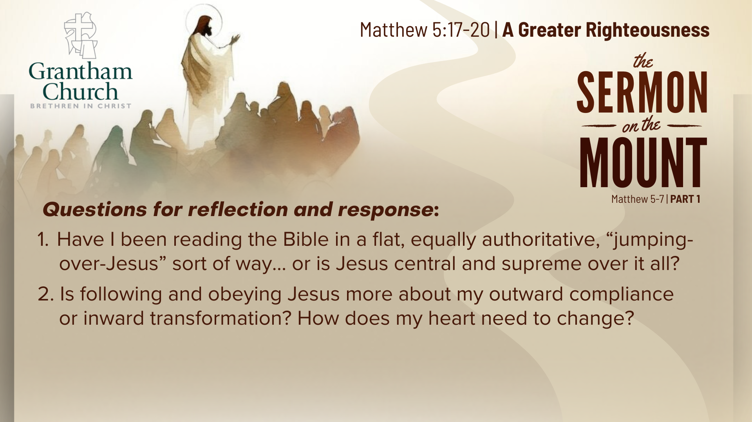

Slide 19
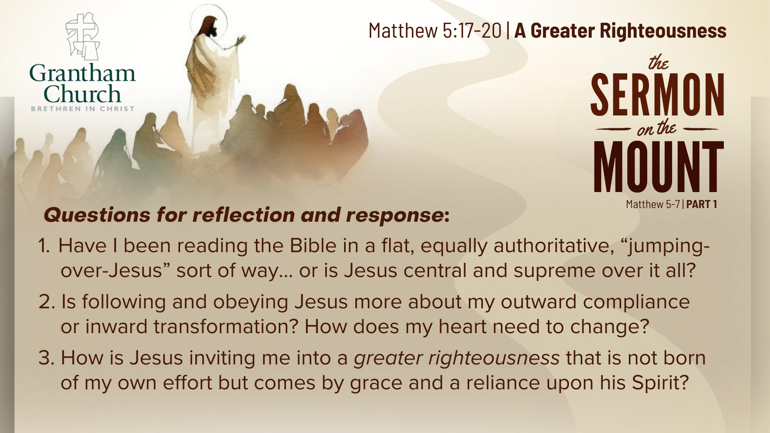
Notes:
[READ & BRIEF COMMENT ON EACH QUESTION]
Have I been reading the Bible in a flat, equally authoritative, “jumping-over-Jesus” sort of way... or is Jesus central and supreme over it all?
Is following and obeying Jesus more about my outward compliance or inward transformation? How does my heart need to change?
How is Jesus inviting me into a greater righteousness that is not born of my own effort but comes by grace and a reliance upon his Spirit?
[CLOSING WORDS]
Let’s pray… [NEXT SLIDE FOR CLOSING PRAYER]

Slide 20
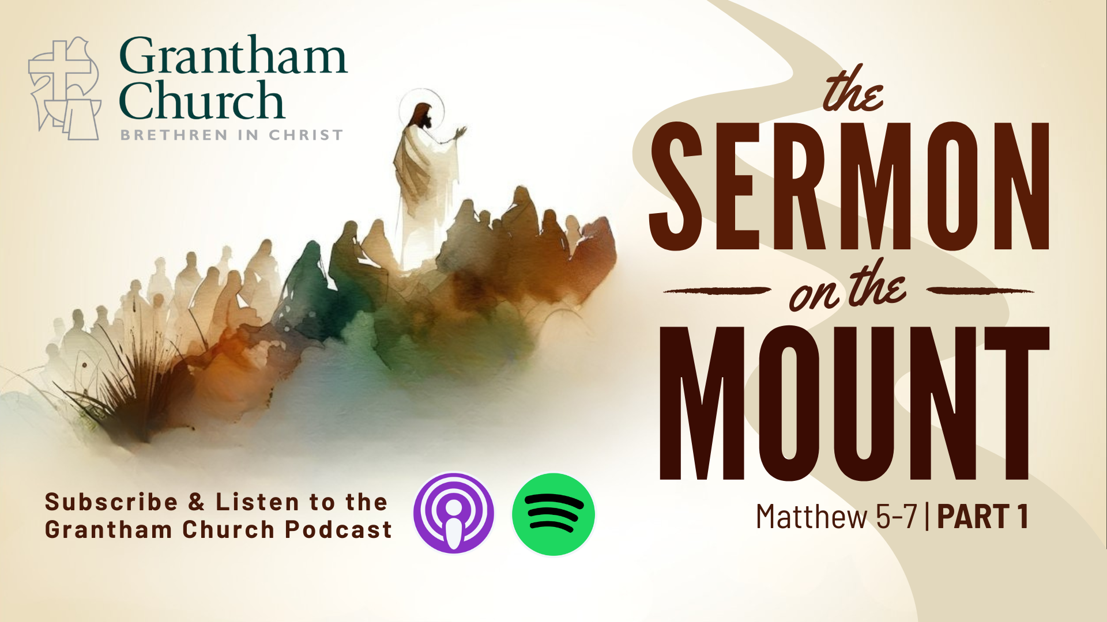
Notes:
[CLOSING PRAYER]
[CLOSING SONG]
[ANNOUNCEMENT]
Benediction
Brothers and sisters, you have heard the words of Jesus and the call to follow him. The path is narrow, but it leads to life. Remember that Christ walks with you, the Father surrounds you, and the Spirit empowers you. Therefore, go in peace, to love and serve the Lord. Amen.

